Slide 1
Error Detection and Correction
Types of Errors
Detection
Correction

Slide 2
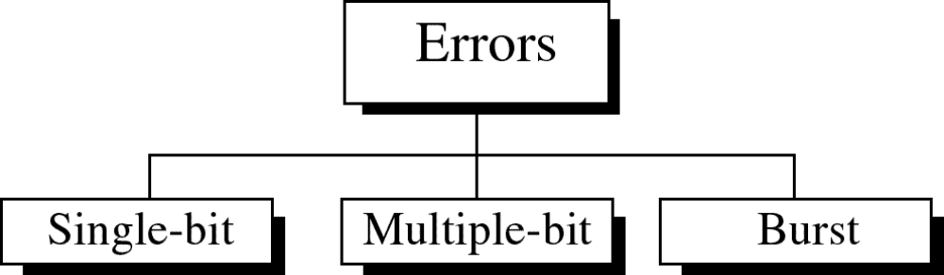
Types of Errors

Slide 3
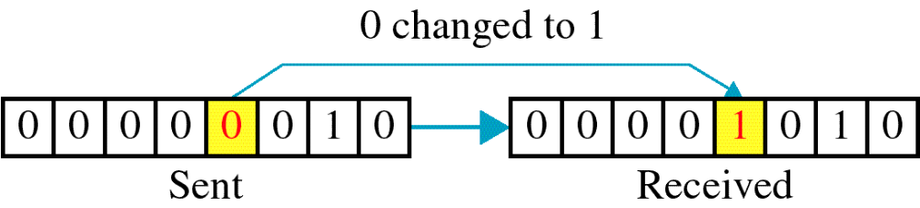
Single-bit error

Slide 4
Single bit errors are the least likely type of errors in serial data transmission because the noise must have a very short duration which is very rare. However this kind of errors can happen in parallel transmission.
Example:
If data is sent at 1Mbps then each bit lasts only 1/1,000,000 sec. or 1 μs.
For a single-bit error to occur, the noise must have a duration of only 1 μs, which is very rare.

Slide 5
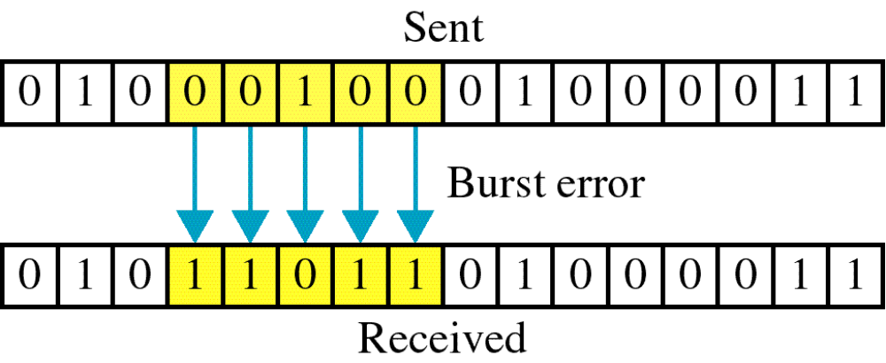
Burst error

Slide 6
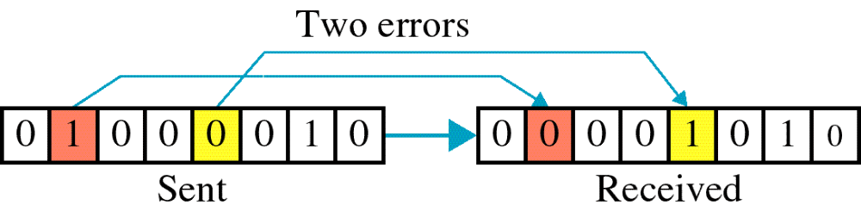

Slide 7
The term burst error means that two or more bits in the data unit have changed from 1 to 0 or from 0 to 1.
Burst errors does not necessarily mean that the errors occur in consecutive bits, the length of the burst is measured from the first corrupted bit to the last corrupted bit. Some bits in between may not have been corrupted.

Slide 8
Burst error is most likely to happen in serial transmission since the duration of noise is normally longer than the duration of a bit.
The number of bits affected depends on the data rate and duration of noise.
Example:
If data is sent at rate = 1Kbps then a noise of 1/100 sec can affect 10 bits.(1/100*1000)
If same data is sent at rate = 1Mbps then a noise of 1/100 sec can affect 10,000 bits.(1/100*10⁶)

Slide 9
Error detection
Error detection means to decide whether the received data is correct or not without having a copy of the original message.
Error detection uses the concept of redundancy, which means adding extra bits for detecting errors at the destination.
Notes:
Make sense of message.
Make sense of message.

Slide 10
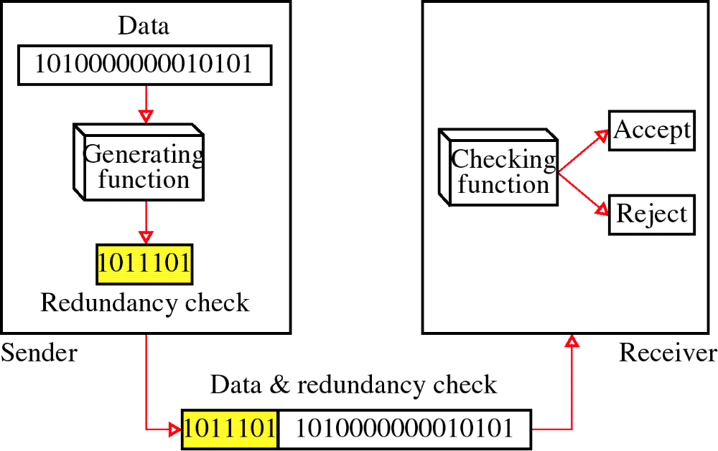
Redundancy

Slide 11
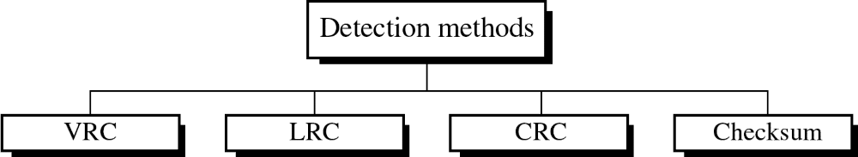
Four types of redundancy checks are used
in data communications

Slide 12
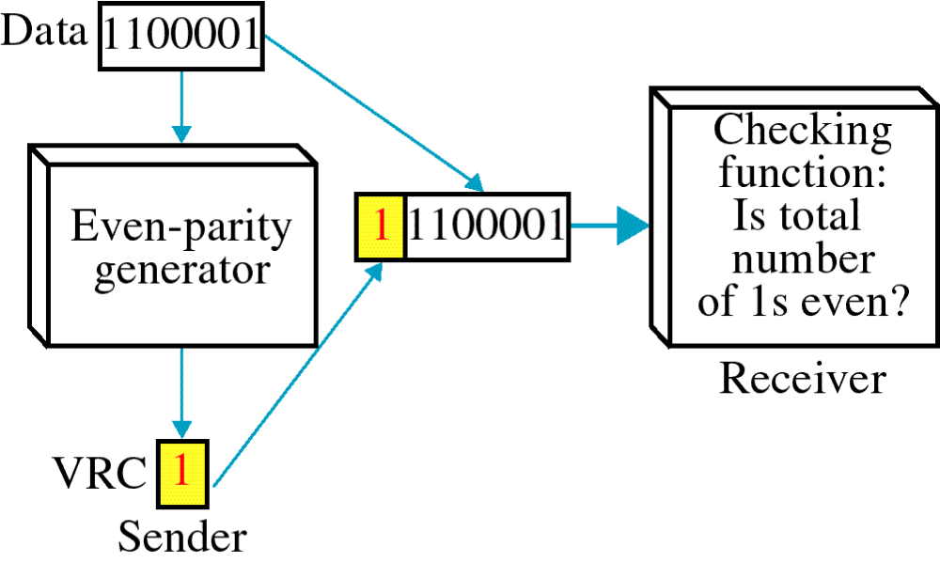
Vertical Redundancy Check
VRC

Slide 13
Performance
It can detect single bit error
It can detect burst errors only if the total number of errors is odd.

Slide 14
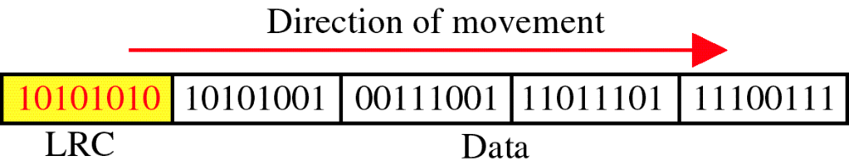
Longitudinal Redundancy Check
LRC

Slide 15
Performance
LCR increases the likelihood of detecting burst errors.
If two bits in one data units are damaged and two bits in exactly the same positions in another data unit are also damaged, the LRC checker will not detect an error.

Slide 16
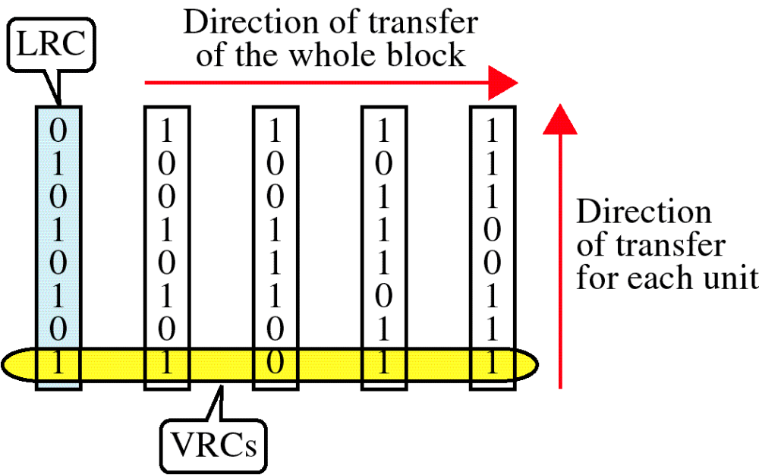
VRC and LRC

Slide 17
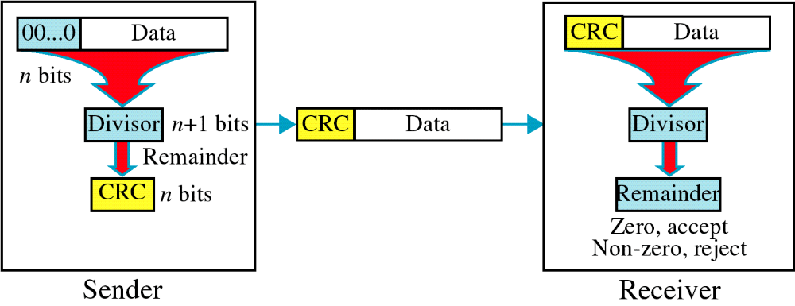
Cyclic Redundancy Check
CRC

Slide 18
Cyclic Redundancy Check
Given a k-bit frame or message, the transmitter generates an n-bit sequence, known as a frame check sequence (FCS), so that the resulting frame, consisting of (k+n) bits, is exactly divisible by some predetermined number.
The receiver then divides the incoming frame by the same number and, if there is no remainder, assumes that there was no error.

Slide 19
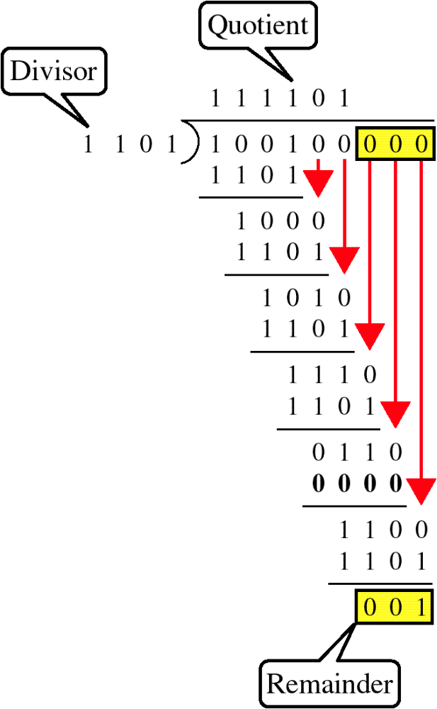
Binary Division

Slide 20
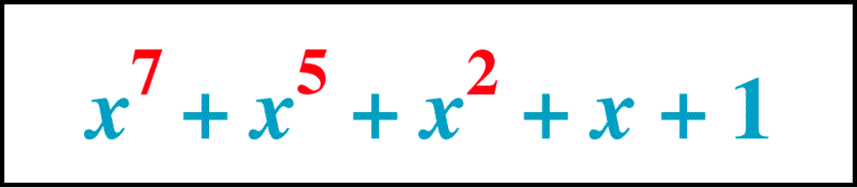
Polynomial

Slide 21
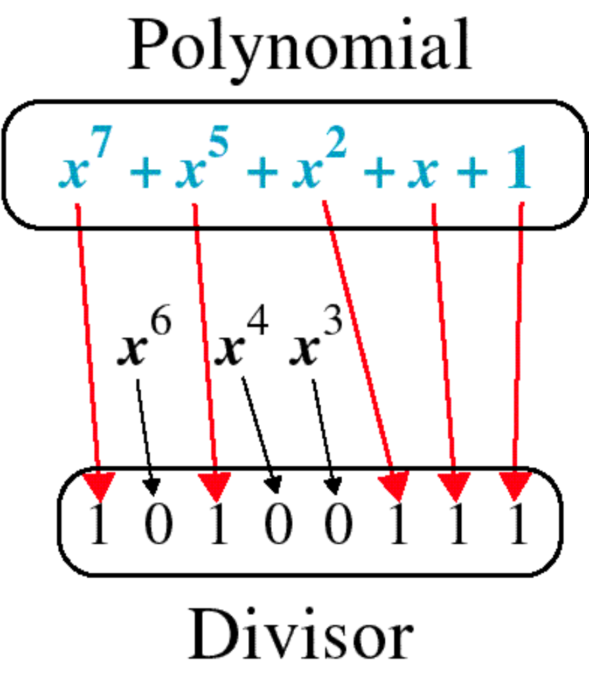
Polynomial and Divisor

Slide 22
Error Correction
It can be handled in two ways:
receiver can have the sender retransmit the entire data unit.
The receiver can use an error-correcting code, which automatically corrects certain errors.

Slide 23
Single-bit error correction
To correct an error, the receiver reverses the value of the altered bit. To do so, it must know which bit is in error.
Number of redundancy bits needed
Let data bits = m
Redundancy bits = r
∴Total message sent = m+r
The value of r must satisfy the following relation:
2^{r} ≥ m+r+1

Slide 24
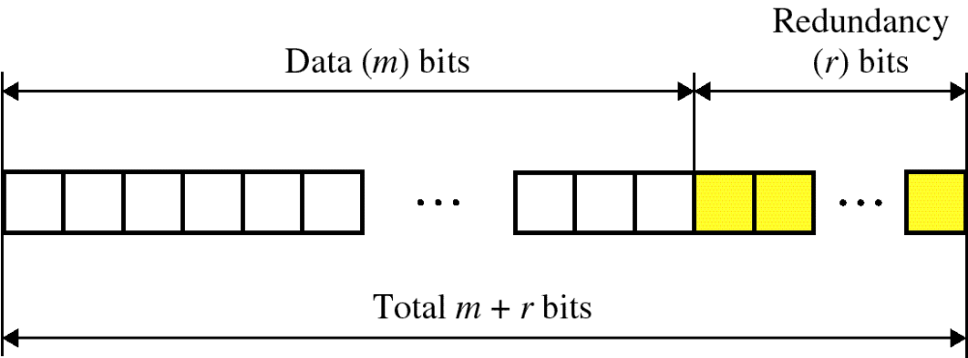
Error Correction

Slide 25
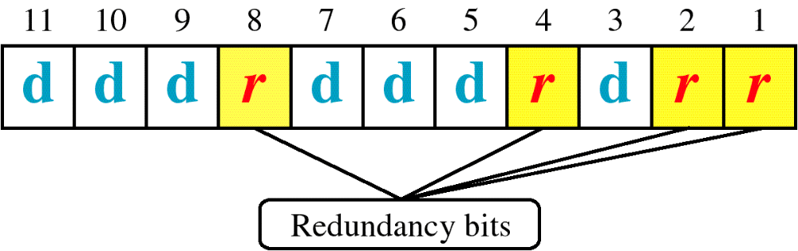
Hamming Code

Slide 26
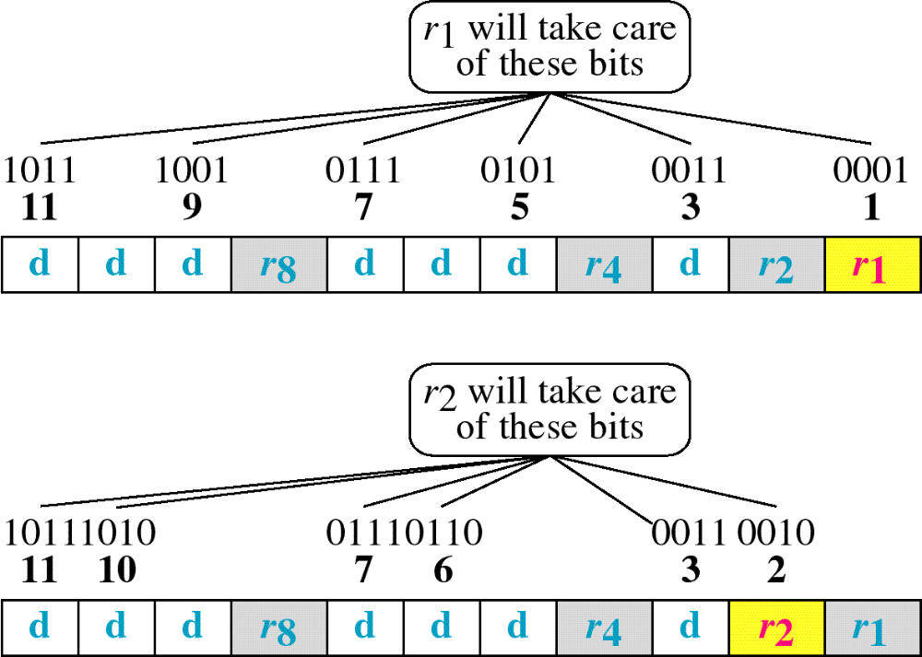
Hamming Code

Slide 27
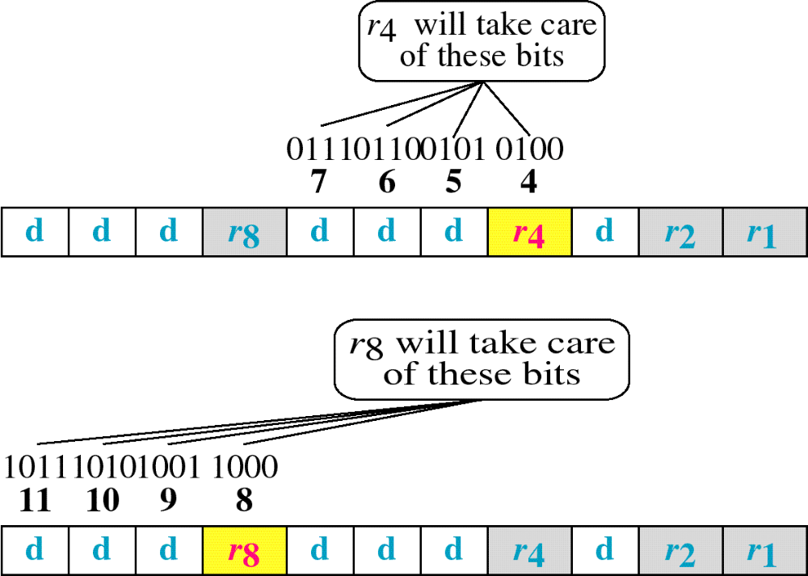
Hamming Code

Slide 28
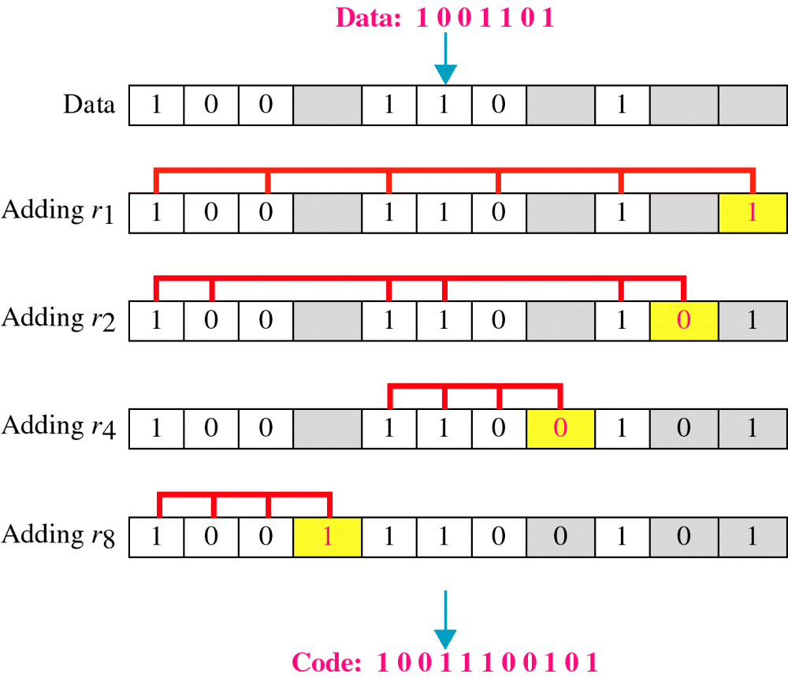
Example of Hamming Code

Slide 29
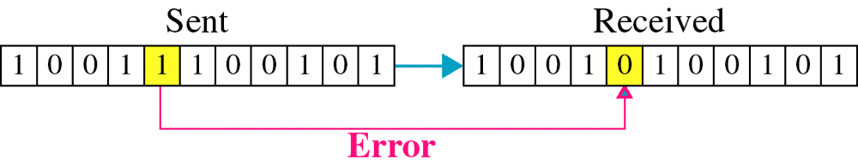
Single-bit error

Slide 30

Error
Detection

